Slide 1






Spring Boot Introduction
Spring MVC, Spring Data
Spring Boot Introduction
SoftUni Team
Technical Trainers
Software University
http://softuni.bg

Slide 2


Table of Contents
Spring Boot Components
Spring MVC
Spring Data

Slide 3
Have a Question?
sli.do #JavaWeb

Slide 4
What is Spring Boot?

Slide 5



Spring Boot
Opinionated view of building production-ready Spring applications
Tomcat
pom.xml
Spring Boot
Auto configuration

Slide 6
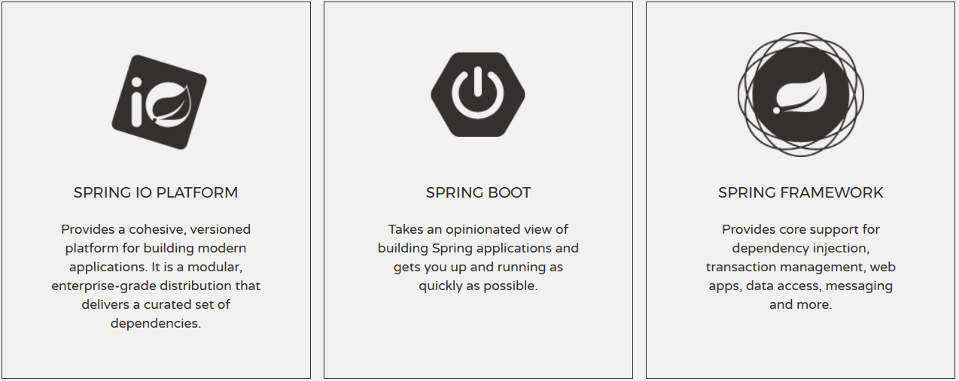
Spring Boot
Spring Boot

Slide 7
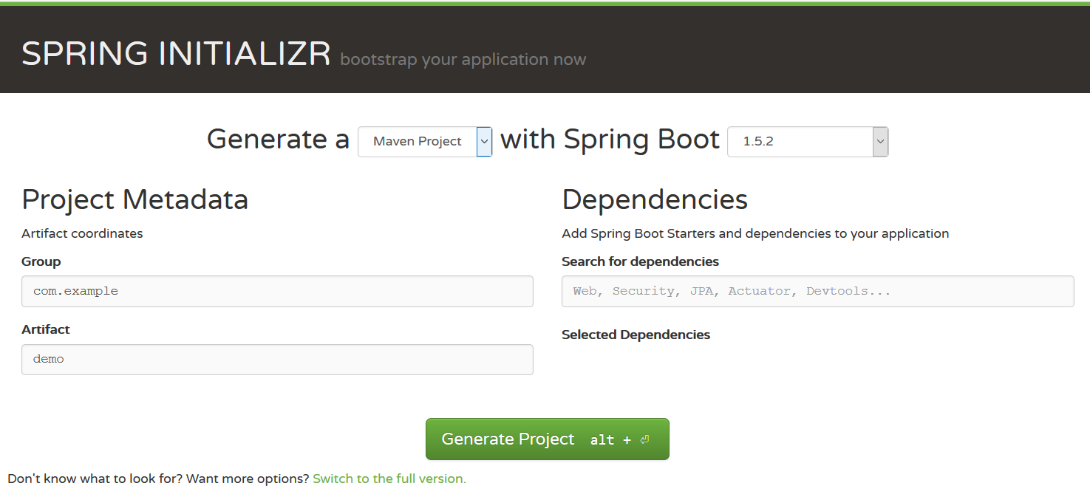
Creating Spring Boot Project
Just go to https://start.spring.io/

Slide 8
Spring Dev Tools
Additional set of tools that can make the application development faster and more enjoyable
pom.xml
<dependency> <groupId>org.springframework.boot</groupId> <artifactId>spring-boot-devtools</artifactId> <scope>runtime</scope> </dependency>

Slide 9
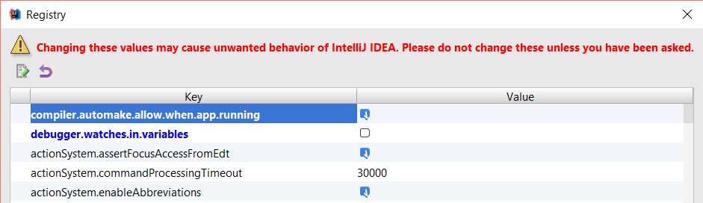
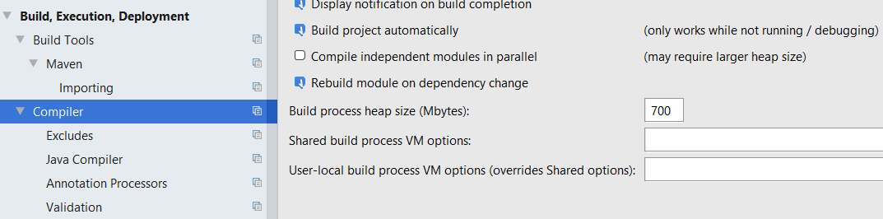
Spring Dev Tools Setup

Slide 10
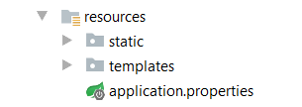
Spring Resources
HTML, CSS, JS
Thymeleaf
App propertues

Slide 11
Spring Boot Main Components
Four main components:
Spring Boot Starters - combine a group of common or related dependencies into single dependency
Spring Boot AutoConfigurator - reduce the Spring Configuration
Spring Boot CLI - run and test Spring Boot applications from command prompt
Spring Boot Actuator – provides EndPoints and Metrics

Slide 12
Spring Boot Starters (1)
pom.xml
<dependency>
<groupId>org.springframework.boot</groupId>
<artifactId>spring-boot-starter-web</artifactId>
<version>1.4.1.RELEASE</version>
</dependency>

Slide 13
Spring Boot Starters (2)
spring-boot-starter-web
spring-boot-starter-tomcat
spring-web
spring-boot-starter
spring-web-mvc
spring-boot
tomcat-embed-logging-juli
spring-boot-autoconfigure
tomcat-embed-core
spring-boot-starter-logging

Slide 14
Spring Boot AutoConfigurator
pom.xml
@Target({ElementType.TYPE})
@Retention(RetentionPolicy.RUNTIME)
@Documented
@Inherited
@SpringBootConfiguration
@EnableAutoConfiguration
@ComponentScan(
excludeFilters = {@Filter(
type = FilterType.CUSTOM,
classes = {TypeExcludeFilter.class}
)}
)
public @interface SpringBootApplication

Slide 15
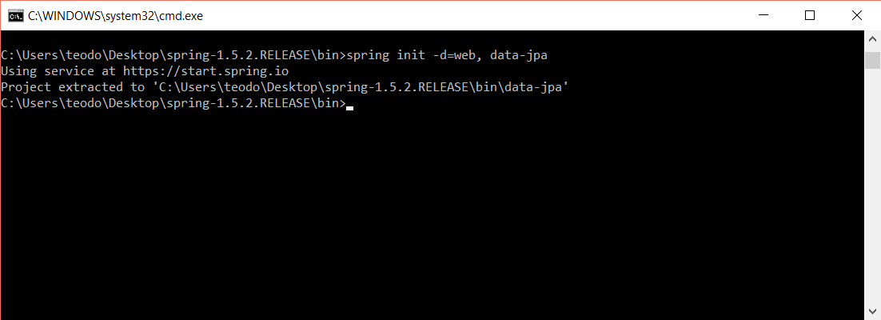
Spring Boot CLI
Command Line Interface - Spring Boot software to run and test Spring Boot applications

Slide 16
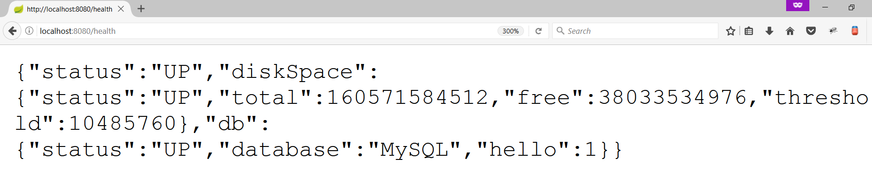
Spring Boot Actuator
Expose different types of information about the running application
pom.xml
<dependency>
<groupId>org.springframework.boot</groupId>
<artifactId>spring-boot-starter-actuator</artifactId>
</dependency>

Slide 17
Inversion of Control
Spring provides Inversion of Control and Dependency Injection
UserServiceImpl.java
UserServiceImpl.java
//Tradiotional Way
public class UserServiceImpl implements UserService {
private UserRepository userRepository = new UserRepository();
}
//Dependency Injection
@Service
public class UserServiceImpl implements UserService {
@Autowired
private UserRepository userRepository;
}

Slide 18
Spring IoC
Meta Data:
XML Config
Java Config
Annotation Config
Automatic Beans:
@Component
@Service
@Repository
Explicit Beans
1. @Bean
IoC
Fully Configured System

Slide 19
Beans
Object that is instantiated, assembled, and otherwise managed by a Spring IoC container
Dog.java
public class Dog implements Animal {
private String name;
public Dog() {}
//GETTERS AND SETTERS
}

Slide 20
Bean Declaration
Dog.java
@SpringBootApplication
public class MainApplication {
…
@Bean
public Animal getDog(){
return new Dog();
}
}
Bean Declaration

Slide 21
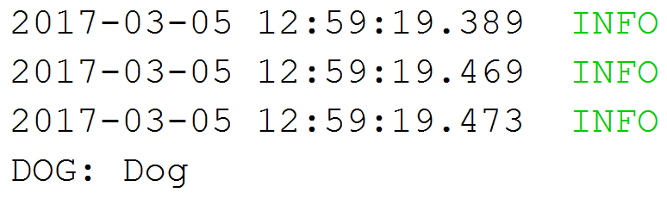
Get Bean from Application Context
MainApplication.java
@SpringBootApplication
public class MainApplication {
public static void main(String[] args) {
ApplicationContext context = SpringApplication.run(MainApplication.class, args);
Animal dog = context.getBean(Dog.class);
System.out.println("DOG: " + dog.getClass().getSimpleName());
}
}

Slide 22
Bean Lifecycle
Instantiation
Set Properties
Set Name
Initialization
Pre Initialization
Set Application Context
When Container is Shutdown
Post Initialization
Bean is ready
Bean is destroyed

Slide 23
Bean Lifecycle Demo (1)
MainApplication.java
@SpringBootApplication
public class MainApplication {
public static void main(String[] args) {
ApplicationContext context = SpringApplication.run(MainApplication.class, args);
((AbstractApplicationContext)context).close();
}
@Bean(destroyMethod = "destroy", initMethod = "init")
public Animal getDog(){
return new Dog();
}
}

Slide 24
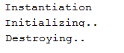
Bean Lifecycle Demo (2)
MainApplication.java
public class Dog implements Animal {
public Dog() {
System.out.println("Instantiation");
}
public void init(){
System.out.println("Initializing..");
}
public void destroy(){
System.out.println("Destroying..");
}
}

Slide 25
Bean Scope
The default one is Singleton. It is easy to change to Prototype
Mostly used as State-less
Mostly used as State-full
Singleton
Prototype
Request A
Request A
Dog 1
Request B
Dog
Request B
Dog 2
Request C
Request C
Dog 3

Slide 26
Bean Scope Demo

Slide 27
What is Spring MVC?

Slide 28
What is Spring MVC?
Model-view-controller (MVC) framework is designed around a DispatcherServlet that dispatches requests to handlers
Find Controller
Handler
Mapping
Controller
Service
Request
Dispatcher Servlet
Execute Action
Handler
Adapter
View Name
Repository
View
Resolver
Result Model
Resolve View
DB
Response
Result Model
View
Model
Business Logic
Notes:
Blue Color – Provided by Spring Purple Color – To Be Implemented by the Developer Green Color – Provided by Spring. Sometimes implemented by the developer

Slide 29
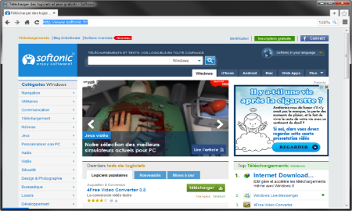



MVC – Control Flow
Web Client
Request
Controller
Response (html, json, xml)
Update Model
User Action
Update View
Notify
Model
View

Slide 30
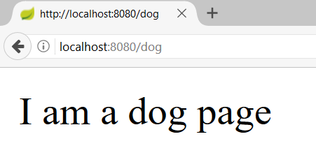
Controllers
Controller
DogController.java
@Controller
public class DogController {
@GetMapping("/dog")
@ResponseBody
public String getDogHomePage(){
return "I am a dog page";
}
}
Request Mapping
Action
Print Text
Text

Slide 31
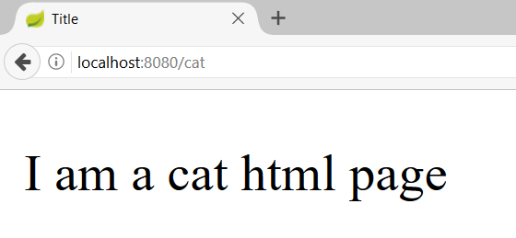
Actions – Get Requests
CatController.java
@Controller
public class CatController {
@GetMapping("/cat")
public String getHomeCatPage(){
return "cat-page.html";
}
}
Request Mapping
Action
View
31

Slide 32
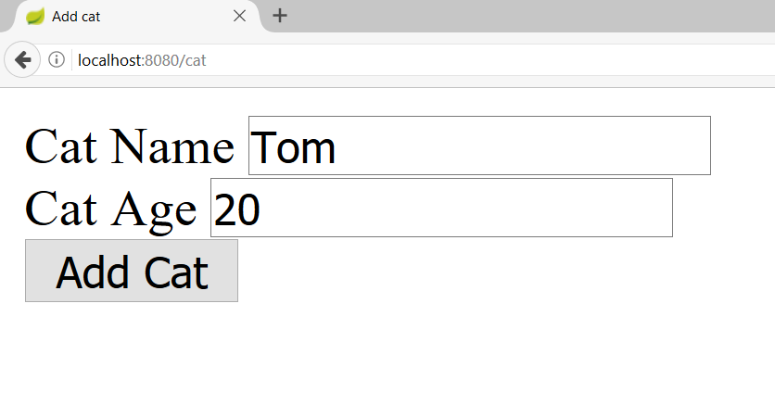
Actions – Post Requests (1)
CatController.java
@Controller
@RequestMapping("/cat")
public class CatController {
@GetMapping("")
public String getHomeCatPage(){
return "new-cat.html";
}
}
Starting route

Slide 33
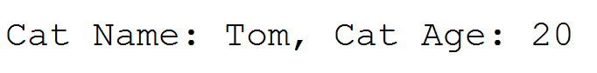
Actions – Post Requests (1)
CatController.java
@Controller
@RequestMapping("/cat")
public class CatController {
@PostMapping("")
public String addCat(@RequestParam String catName, @RequestParam int catAge){
System.out.println(String.format("Cat Name: %s, Cat Age: %d", catName, catAge));
return "redirect:/cat";
}
}
Request param
Redirect

Slide 34
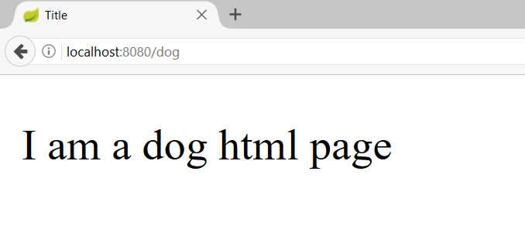
Models and Views
DogController.java
@Controller
public class DogController {
@GetMapping("/dog")
public ModelAndView getDogHomePage(ModelAndView modelAndView){
modelAndView.setViewName("dog-page.html");
return modelAndView;
}
}
Model and View

Slide 35
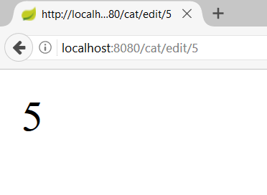
Path Variables
CatController.java
@Controller
@RequestMapping("/cat")
public class CatController {
@GetMapping("/edit/{catId}")
@ResponseBody
public String editCat(@PathVariable long catId){
return String.valueOf(catId);
}
}
Path Variable

Slide 36
Spring MVC Demo

Slide 37
Spring Data

Slide 38
Overall Architecture
Repository
Service
Controller
Database
View
Entities
Models/ DTO
Back-end

Slide 39
Application Properties
application.properties
#Data Source Properties
spring.datasource.driverClassName=com.mysql.jdbc.Driver
spring.datasource.url=jdbc:mysql://localhost:3306/cat_store?useSSL=false&createDatabaseIfNotExist=true
spring.datasource.username=root
spring.datasource.password=1234
#JPA Properties
spring.jpa.properties.hibernate.dialect=org.hibernate.dialect.MySQL5InnoDBDialect
spring.jpa.properties.hibernate.format_sql=TRUE
spring.jpa.hibernate.ddl-auto=update

Slide 40
Entities
Entity is a lightweight persistence domain object
Cat.java
@Entity
@Table(name = "cats")
public class Cat {
@Id
@GeneratedValue(strategy = GenerationType.IDENTITY)
private long id;
private String name;
//GETTERS AND SETTERS
}

Slide 41
Repositories
Persistence layer that works with entities
CatRepository.java
@Repository
public interface CatRepository extends CrudRepository<Cat, Long> {
}

Slide 42
Services
Business Layer. All the business logic is here.
CatService.java
@Service
public class CatServiceImpl implements CatService {
@Autowired
private CatRepository catRepository;
@Override
public void buyCat(CatModel catModel) {
//TODO Implement the method
}
}

Slide 43
Spring Data Demo

Slide 44

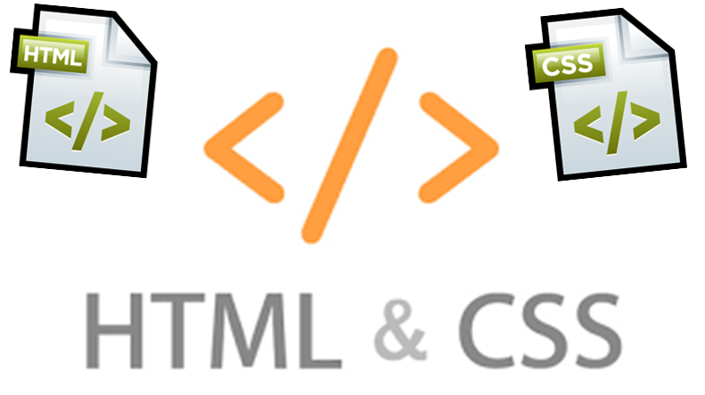
Summary
Spring Boot - Opinionated view of building production-ready Spring applications
Spring MVC - MVC framework that has three main components:
Controller - controls the application flow
View - presentation layer
Model - data component with the main logic
Spring Data - Responsible for database related operations

Slide 45








Web Development Basics – Course Overview
https://softuni.bg/courses/

Slide 46
License
This course (slides, examples, demos, videos, homework, etc.) is licensed under the "Creative Commons Attribution-NonCommercial-ShareAlike 4.0 International" license

Slide 47






Free Trainings @ Software University
Software University Foundation – softuni.org
Software University – High-Quality Education, Profession and Job for Software Developers
softuni.bg
Software University @ Facebook
facebook.com/SoftwareUniversity
Software University @ YouTube
youtube.com/SoftwareUniversity
Software University Forums – forum.softuni.bg

